Slide 1
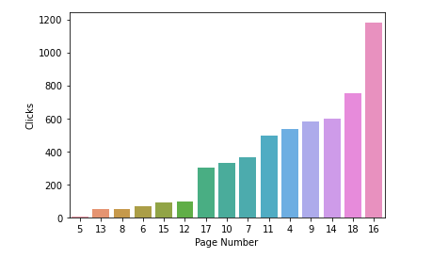
Most clicked anxiety pages

Slide 2

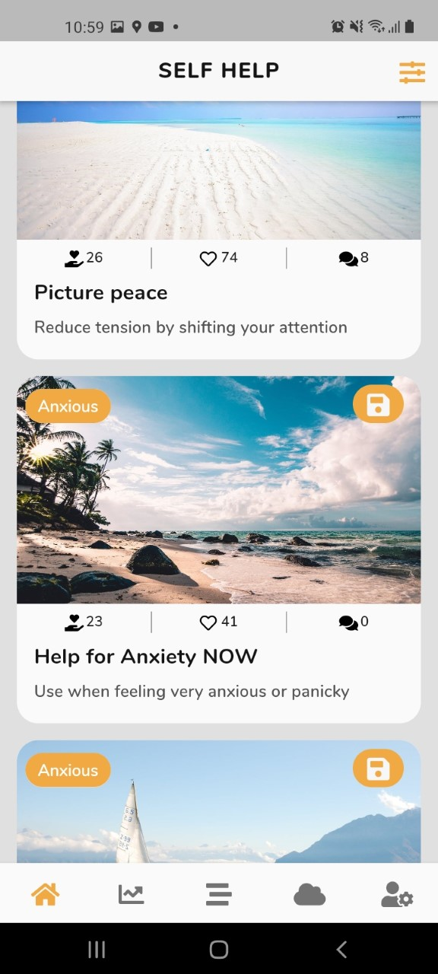
Most clicked anxiety pages
Page 16 "<p><b>A visual activity which can help to engage your attention away from anxious feelings, thoughts and sensations.</b></p><ul><li>Find a quiet place</li><li>Choose one of the images</li><li>Rub the screen to see the image emerge</li><li>Allow your eyes to move over the image</li><li>Pay attention to the details of the image</li></ul><p></p><p>If you like that, try this video of <a href="https://www.youtube.com/watch?v=4IRLvYOZD8A">Fractals in nature</a>.</p>" Visual exercise

Slide 3
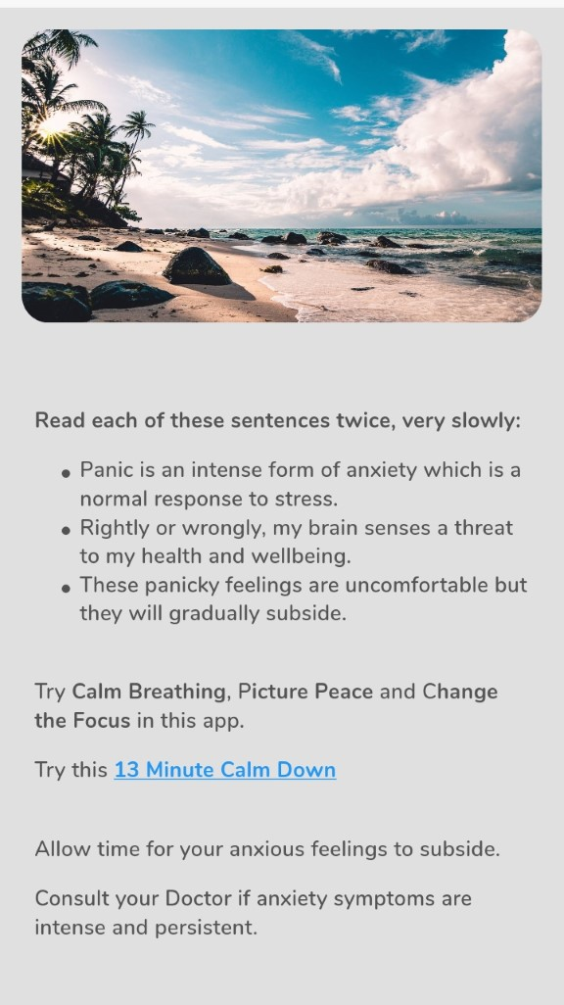
Most clicked anxiety pages
Page 18 "<p><b>The first words to say to yourself to help you contain your anxious feelings.</b></p>" Mental exercise

Slide 4
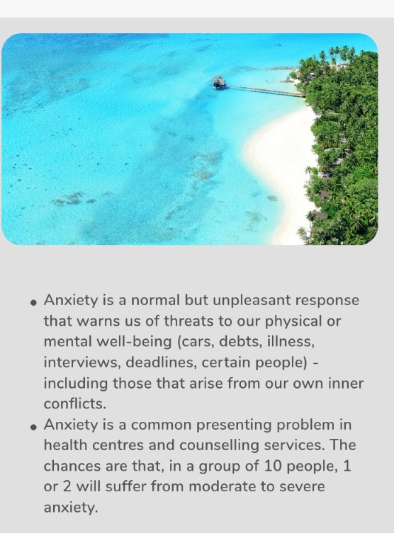
Most clicked anxiety pages
Page 14 "<p><b>Two facts about anxiety which may help to put your experience into perspective.</b></p>" Information

Slide 5
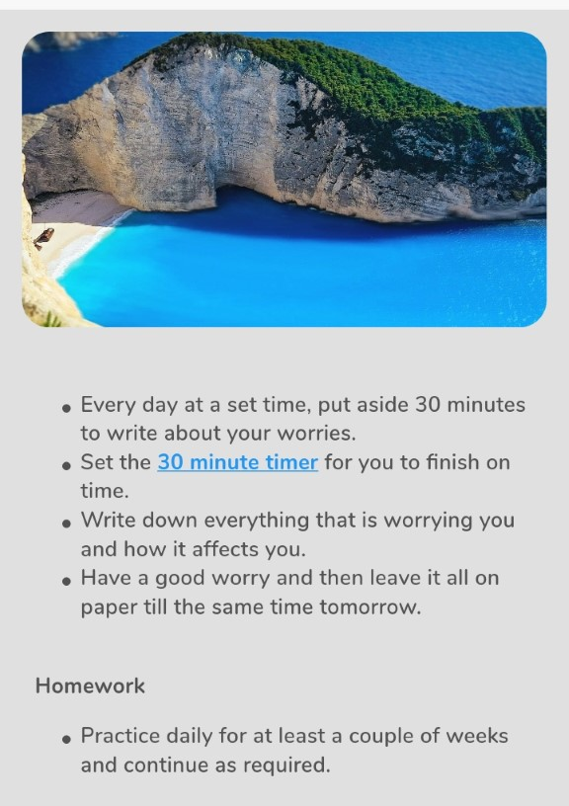
Most clicked anxiety pages
Page 9 "<p><b>A writing exercise which can help to reduce the persistence of anxious thoughts in daily life.</b></p>" Written exercise

Slide 6
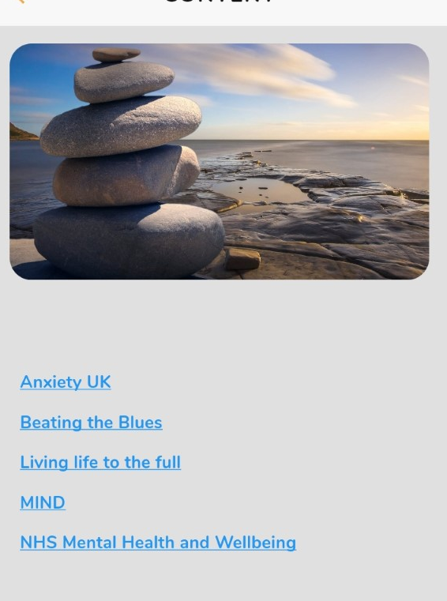
Most clicked anxiety pages
Page 4 "<p><b>Use these links to obtain further self-help information and resources from established mental health organisations.</b></p>" Links

Slide 7
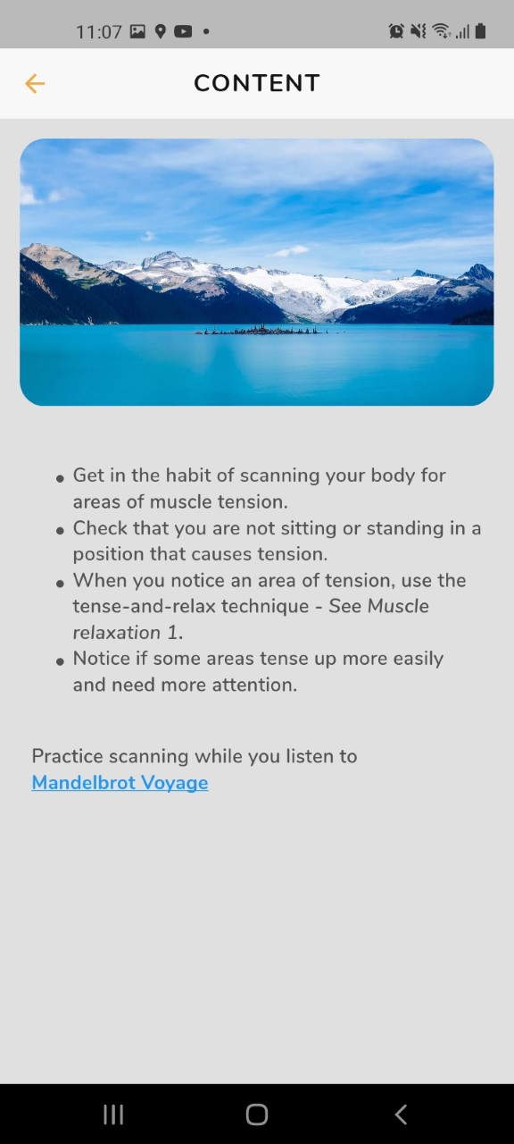
Most clicked anxiety pages
Page 11-"<p><b>An exercise for checking bodily tension that you can use anywhere.</b></p>"Mental exercise

Slide 8
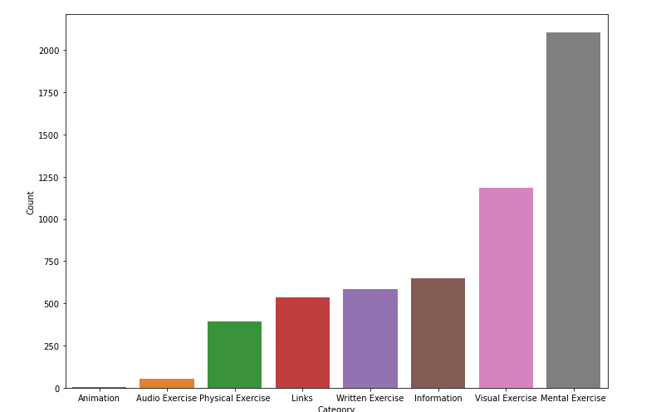
Most clicked anxiety pages

Slide 9
Most clicked coping pages

Slide 10
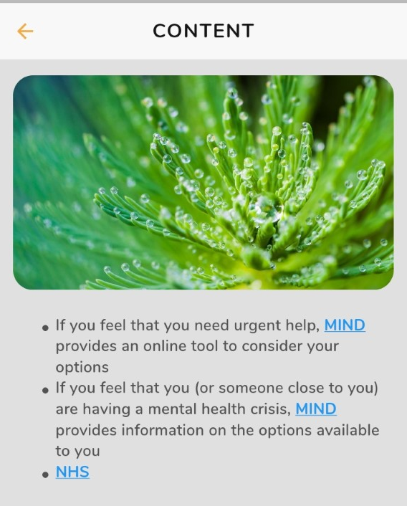
Most clicked coping pages
Page 59 "<p><b>Links to mental health helplines for yourself and other people</b></p>" Links

Slide 11
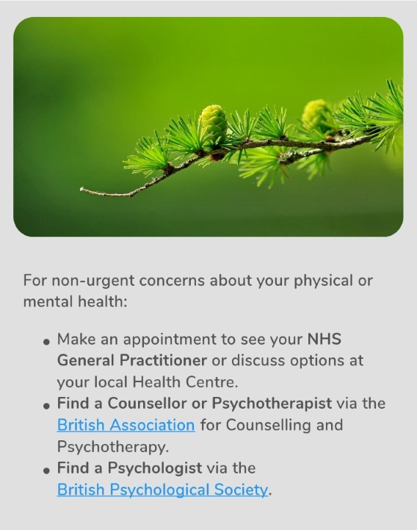
Most clicked coping pages
Page 57 "<p><b>Contact information for non-urgent mental health concerns.</b></p>" Links

Slide 12
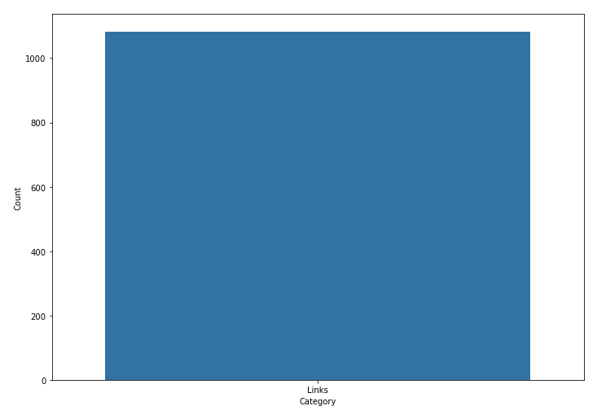
Most clicked coping pages

Slide 13
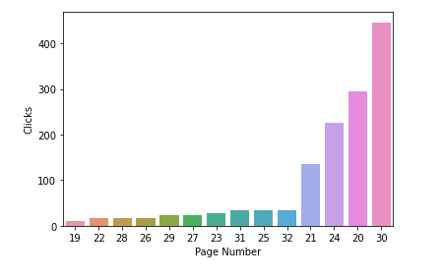
Most clicked depression pages

Slide 14
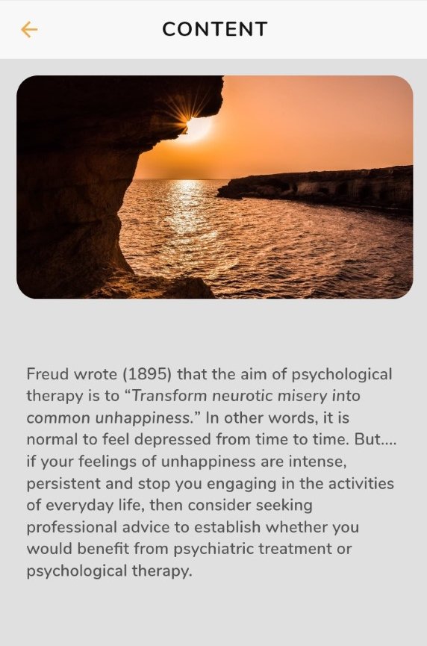
Most clicked depression pages
Page 30-"<p><b>A quotation from Sigmund Freud the psychoanalyst and its implications.</b></p>" Information

Slide 15
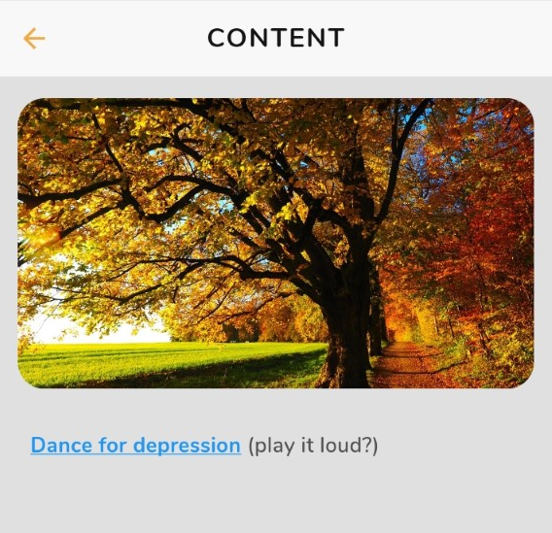
Most clicked depression pages
Page 20- "<p></p><p><b>A national initiative on depression including a dance tutorial for you to use.</b></p>" Physical exercise

Slide 16
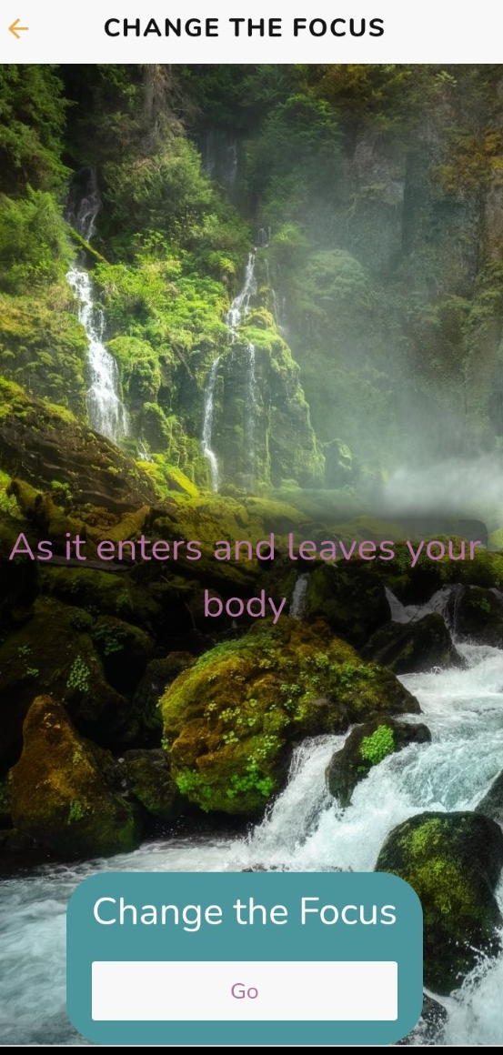
Most clicked depression pages
Page 24 "<p><b>A mental exercise for developing focusing skill and helping to reduce the impact of depressed feelings, together with a training video.</b></p><ul><li>Focus on your breath as it enters and leaves your body" Mental exercise

Slide 17
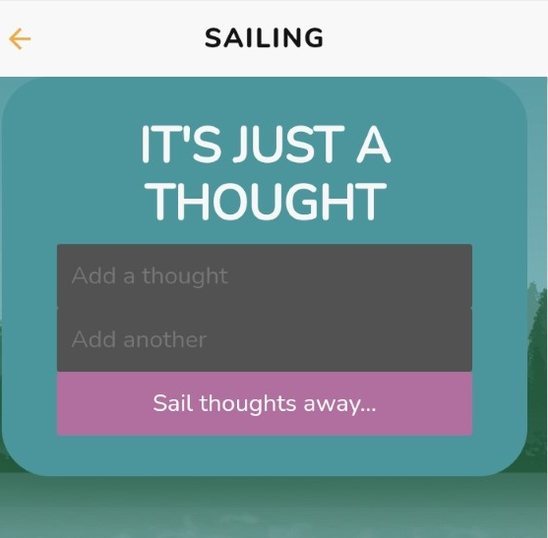
Most clicked depression pages
Page 21 "<p><b>A mental exercise to practice letting go of unwanted thoughts together with animations.</b></p><p></p><p>Find a quiet place, close your eyes and:</p><ul><li>Picture your thoughts as boats sailing down a river.</li><li>Picture yourself sitting on the riverbank, watching the boats go by.</li><li>Stay where you are and let your thoughts drift away.</li></ul><p></p><p><b>Homework</b></p><ul><li>Practice twice daily for two weeks and then use as required.</li></ul>" Mental Exercise

Slide 18
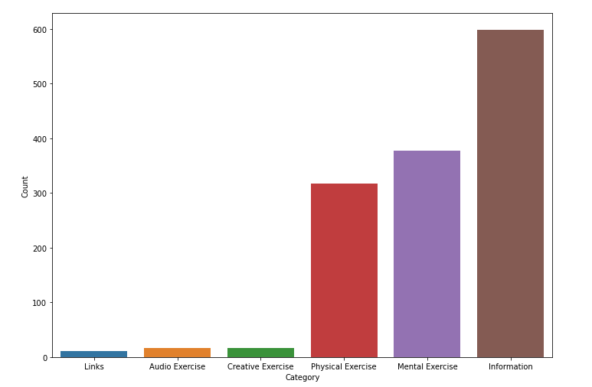
Most clicked depression pages

Slide 19
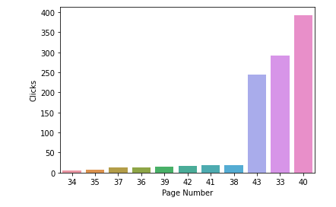
Most clicked lonely pages

Slide 20
Most clicked lonely pages
Page 40-"<p><b>A mental exercise for developing focusing skill, helping to reduce the impact of unwanted thoughts, together with a training video.</b></p><ul><li>Focus on your breath as it enters and leaves your body.</li><li>Now find and focus on a sound nearby.</li><li>One by one, shift your attention focus to other sounds nearby.</li><li>One by one, shift your attention focus to sounds further away.</li><li>Return your attention focus to your breathing.</li></ul><p><b>" Mental exercise

Slide 21
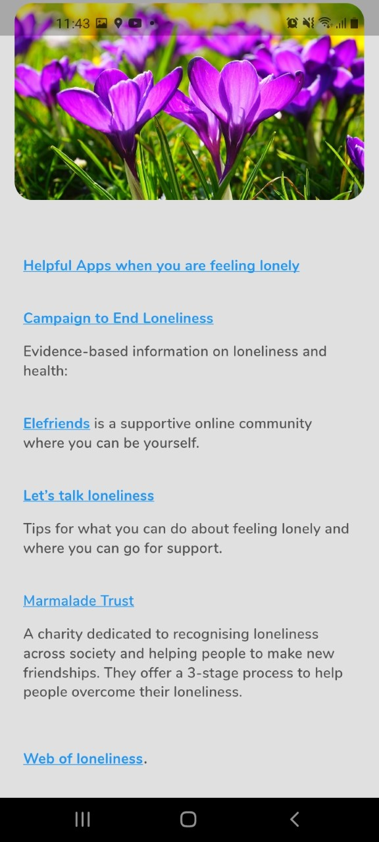
Most clicked lonely pages
Page 33 "<p><b>Check out these options for helping you to connect with other people.</b></p>" Links

Slide 22
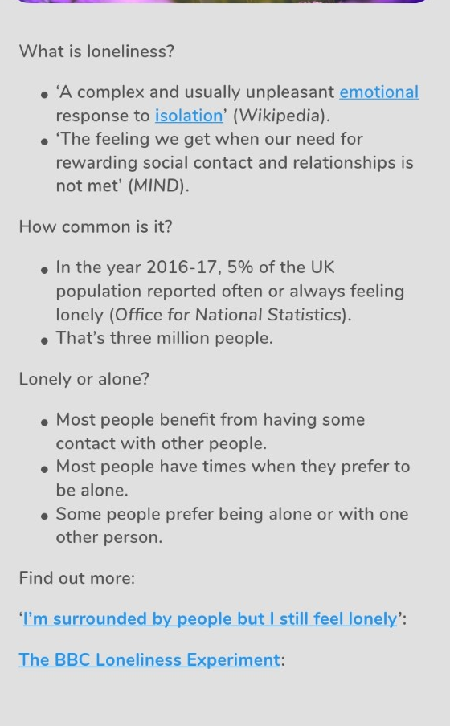
Most clicked lonely pages
Page 43 "<p><b>A definition and basic facts about loneliness with links to more information.</b></p>" Links

Slide 23
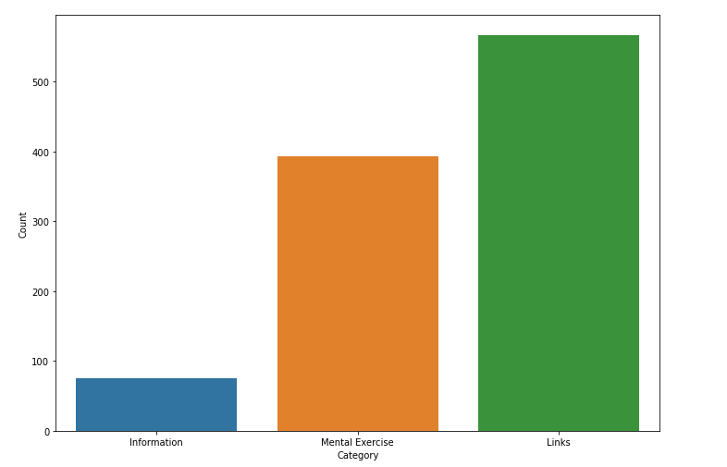
Most clicked lonely pages

